Slide 1


Mantid Scientific Steering Committee
Nick Draper
18/06/2010

Slide 2



Major Tasks presented last meeting
SNS
  Load SNS Histogram data
  Load HFIR Sans data
  Load Event Data
  Filter / split event data (script only)
  SNS Instrument definitions
  Powder Diffraction scripts
  Integration with Inelastic Convert To Energy GUI
  Investigate SANS user interface suitability

Slide 3

Major Tasks presented last meeting
ISIS
  Muon GUI implementation
  Indirect ConvertToEnergy GUI
  SANS GUI improvements
  File loading by specifying 556 or 1012, or WISH324
  Icat searching interface
  Script library integration
  Ikeda carpenter & B2B fits on any unit
  Easy user control for plotting distribution data
  Sequential Peak fitting and plotting vs log values
  Improved NumPy integration
  Continued work on Monte carlo absorption correction
  Matlab interface?

Slide 4
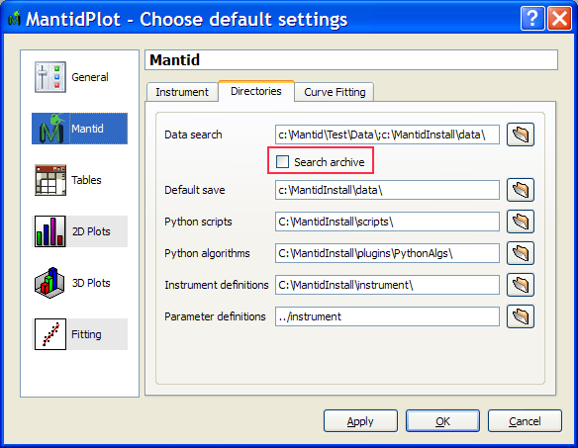
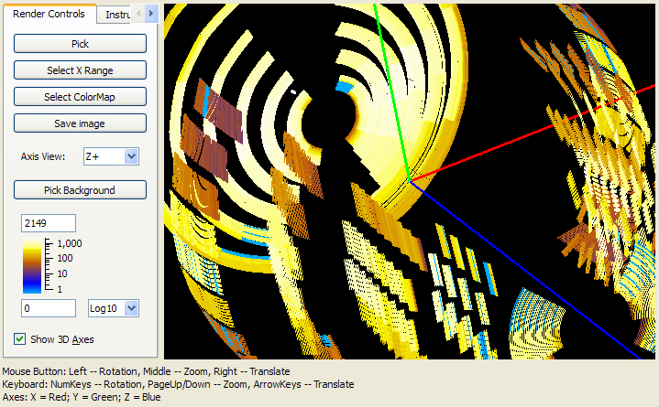
Progress over the last iteration
User interface changes
  Loading by run number
  Archive searching (ISIS)
  Background progress reporting
  Improved Manage Custom Menus
  Improved automatic log scaling
  Axes on the instrument view

Slide 5
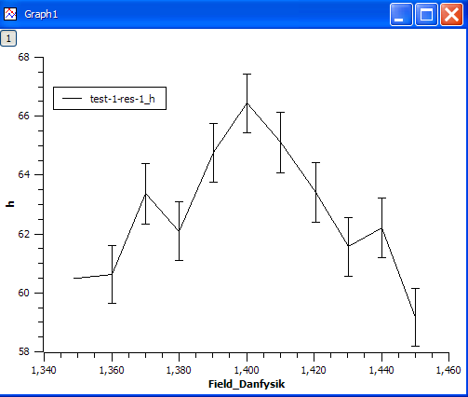
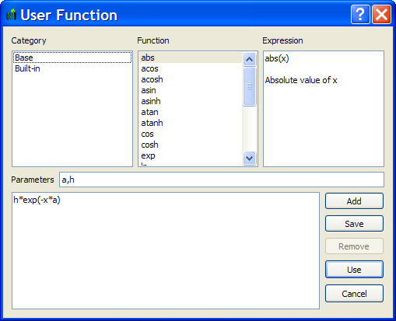
Progress over the last iteration
Curve Fitting
  Sequential peak fitting →
  peak parameters vs log value
  Automatic Peak Finding
  Ikeda carpenter and B2B exponentional fits on any unit
  User defined function Dialog

Slide 6
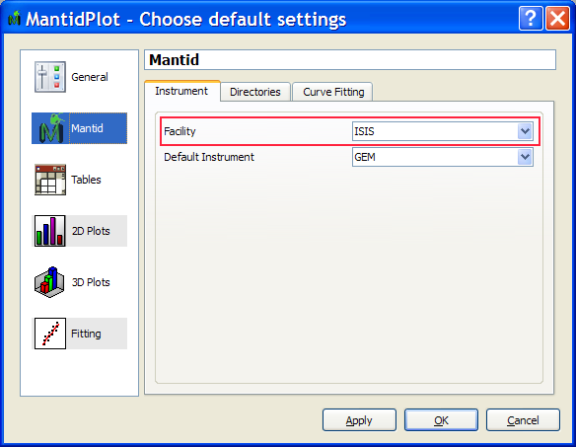
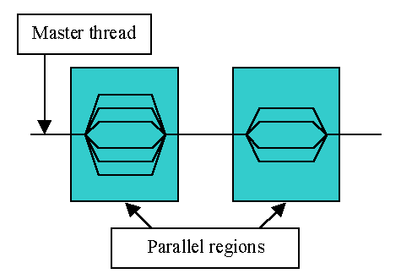
Progress over the last iteration
Framework
  Multiple facility support
Performance
  Multithreaded various algorithms for Direct Inelastic Convert To Energy
  Peak fitting improved by only considering peak functions over a set number of widths

Slide 7
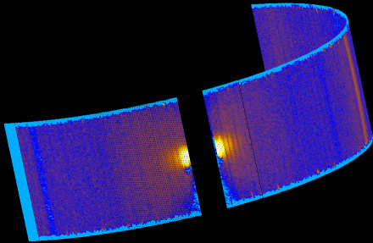
Progress over the last iteration
Event data
  Event Workspace
    Data visible as histogram
    Maintains original events
  Loaded from prenexus files
  Basic support on most algorithms
  Some specific algorithms maintain events
ORNL instrument support
  Basic Powder diffraction support
  Basic Direct Inelastic Convert To Energy support
  HFIR SANS support via script

Slide 8
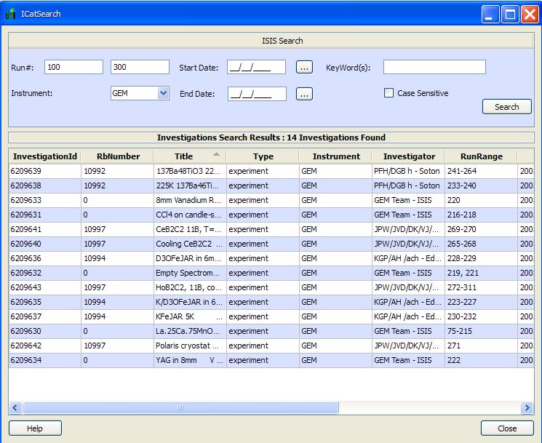
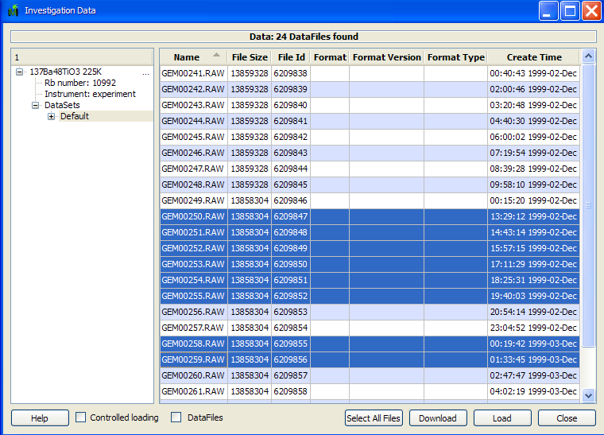
Progress over the last iteration
ICAT interface
  My Data
  ISIS Search
  Advanced Search
  Download Files
    Internally resolves location
    Externally downloads file
  Currently ISIS only

Slide 9
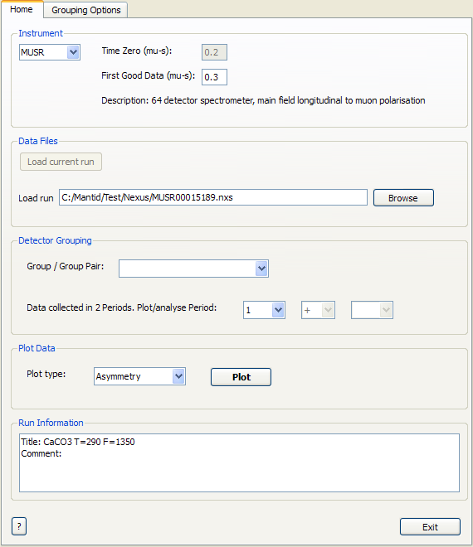
Progress over the last iteration
SANS
  Tab for Summing raw files
  Improved saving options
Muon
  New MuonAnalysis interface
    Replaces much of the functionality of UDA
  Fixed calculation bug in PlotAssymetryByLogValue
Indirect Inelastic
  Now supported in Convert to Energy
  Prototype IndirectAnalysis interface

Slide 10
Progress over the last iteration
Powder Diffraction
  MultipleScatteringCylinderAbsorption algorithm added
  FFTSmooth: Butterworth Filter option added
  PowGen: GhostCorrection added
Instrument Definitions
  SNS: Powgen, Arcs, Sequoia & Cncs
  ISIS: Engin-X & Emu
Crashes/Bugs
  11 Notable bugs corrected.

Slide 11
Next Release
Target Date
  31st October 2010
Major Items
  General
    Easy user control for plotting distribution data
    Script Library integration
    Multi file loading and summing
    Script library integration
    Engineering support
  Technical
    VS2010
    Build System improvements
    Code and quality review
    Windows 7?

Slide 12
Next Release
  SNS
    Filter / split event data (script only)
    SNS meta data (ICAT) search
    Event Workspace improvements
    Initial indirect inelastic integration
    Further Powder diffraction integration
    Further direct inelastic interface integration
    Preliminary event nexus support
  HFIR
    SANS GUI integration
    Triple Axis support

Slide 13
Next Release
Major Items
  ISIS
    Continued work on Monte carlo absorption correction
    Matlab interface
    Tosca (Vision) support
    Vesuvio support
  Visualisation and Analysis
    Limited Prototype
      Multidimensional workspaces
      4 Dimensional parallel visualization of large datasets
      Initial cutting and slicing operations
      Simple background quantification

